Slide 1
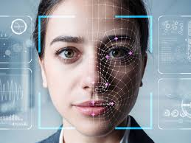
EMOTION ANALYZER
Presented by:
Kapil dev
Ravi kumar
Teesha kumari
Kantesh

Slide 2
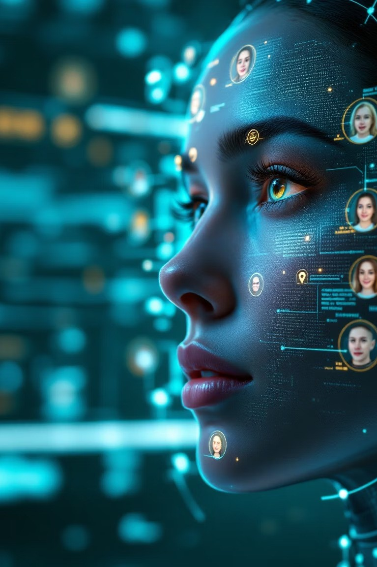
Introduction
An Emotion Analyzer is a system or tool that uses Artificial Intelligence (AI) and Natural Language Processing (NLP) to detect and interpret human emotions from various data sources such as text, speech, facial expressions, or physiological signals.

Slide 3

The Science Behind Emotions
Universal Expressions
Voice Patterns
Humans share six basic emotions across cultures: happiness, sadness, anger, fear, disgust, and surprise.
Vocal biomarkers like pitch, tone, and rhythm reveal emotional states regardless of language.
These emotions create distinctive facial muscle movements called Action Units.
Micro-variations in speech can expose hidden feelings even when faces remain neutral.

Slide 4


How Emotion Analyzers Work
Data Collection
Cameras capture facial expressions while microphones record voice patterns.
Feature Extraction
AI identifies key facial points and vocal characteristics.
Analysis
Machine learning algorithms compare patterns to emotional databases.
Interpretation
Results display emotional states with confidence scores.

Slide 5
Key Applications
Customer Experience
Gauges reactions to products and services in real-time.
Security
Identifies suspicious behavior at airports and public spaces.
Mental Health
Monitors emotional patterns to detect depression and anxiety.
Helps companies improve customer satisfaction.
Assists law enforcement in interrogation analysis.
Automotive
Detects driver drowsiness and emotional distress.
Provides objective data for therapists and psychiatrists.
Adjusts vehicle settings for safer driving.

Slide 6

Our Implementation
Multi-Modal Fusion
Combines facial, vocal, and text analysis for higher accuracy.
Real-Time Processing
Processes emotions in under 500 milliseconds.
Cloud Architecture
Scales across devices with centralized learning.
Privacy-Preserving
Anonymizes personal data with on-device processing.
.

Slide 7
Experimental Results
120
80
40
0
Happiness Sadness Anger Fear Disgust Surprise
Our system achieved 85% overall accuracy across all emotions. Testing included 5,000 diverse subjects from multiple ethnicities and age groups.

Slide 8

Ethical Considerations
Privacy Concerns
Emotion data is deeply personal and requires strict protection. Users must provide informed consent before analysis begins.
Bias Problems
Systems may misinterpret emotions across different cultures. Facial expressions vary significantly between demographic groups.
Manipulation Risks
Emotion data could be misused for targeted marketing. Potential exists for emotional manipulation in political contexts.
Our Approach
Transparent opt-in policies with clear data usage explanations. Diverse training data and continuous bias auditing.

Slide 9

Future Directions
AI Integration
Merging emotion analysis with conversational AI for empathetic virtual assistants.
Enabling machines to adapt responses based on user emotional states.
Medical Applications
Early detection of neurological conditions through emotional biomarkers.
Remote monitoring for patients with mood disorders.
Multimodal Expansion
Including physiological signals like heart rate and skin conductance.
Developing context-aware systems that understand situational emotions.
The future holds tremendous potential for emotion-aware technologies that genuinely understand and respond to human needs.

Slide 10


Slide 11


